Slide 1
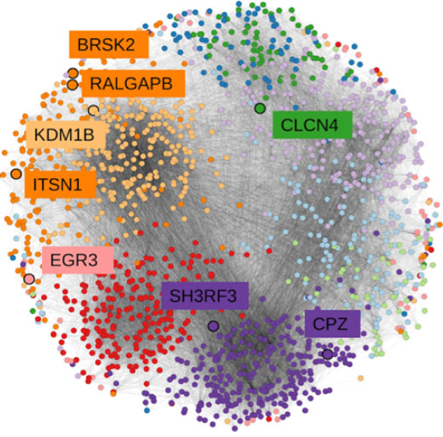

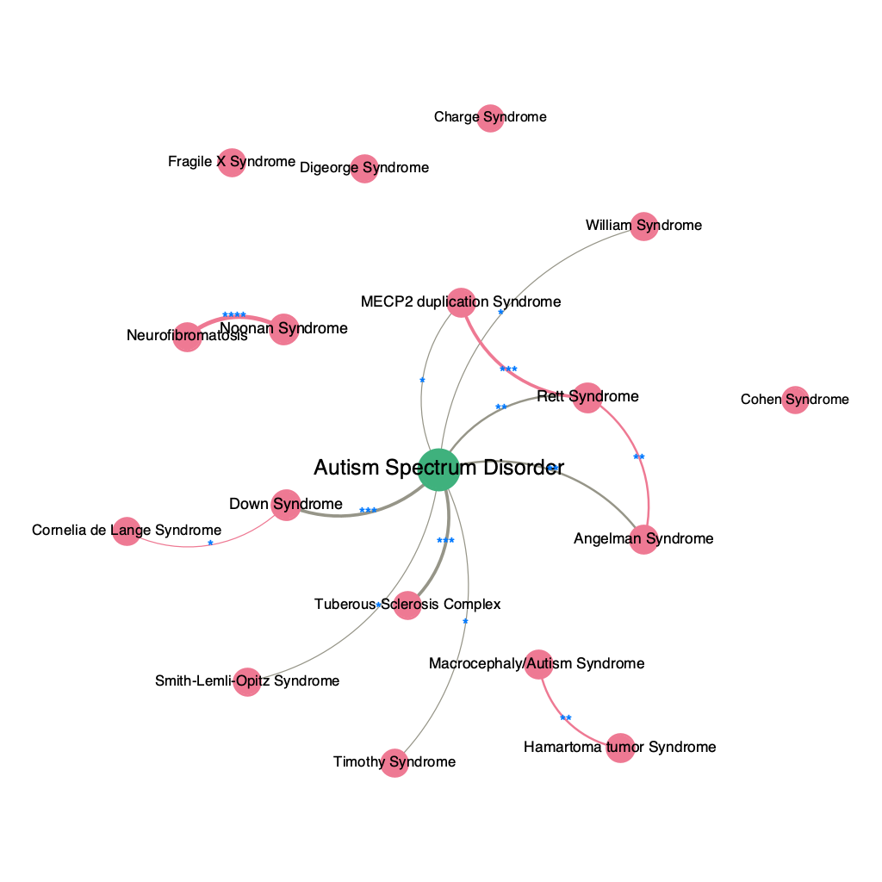
Syndromic vs Non-Syndromic Autism
An Analysis of Disease-to-Disease Network and Disease-to-Gene Network
Presenter: Hao CHEN

Slide 2
Syndromic Autism vs Non-syndromic Autism
Autism - High Heritability & Genetic Heterogeneity (Tick et al, 2016)
60-90% concordance in monozygotic twins
Syndromic Autism vs Non-syndromic Autism (Sztainberg & Zoghbi, 2016)
 | Syndromic Autism | Non-syndromic Autism
Proportion | 5-15% of autism | 85-95% of autism
Genetic features | Known genetic causes; Mono-genetic disorders and chromosomal re-arrangement | Unknown genetic causes Genetic heterogeneity GWA (Genome-wide Association Studies) only explain a small portion of heritability
Clinical Presentation | Autism is a comorbidity of underlying complex syndrome | Autism without complex cluster of symptoms
Examples | Fragile X syndrome, Rett syndrome, MECP2 duplication syndrome, tuberous sclerosis complex | Autism Spectrum Disorder (Asperger’s syndrome, pervasive developmental disorder, classic autism)

Slide 3
Research Question & Data Source
How to differentiate syndromic and non-syndromic autism in gene-to-disease network and disease-to-disease networks?
Data sources: DisGeNet Database (Piñero et al., 2020)
Expert Curated Data
Gene-disease associations (GDAs) collected from following databases: UniProt, PsyGeNET, Orphanet, the CGI, CTD (human data), ClinGen, and the Genomics England PanelApp
10370 diseases
9413 gene
Notes:
Before diving into the network analysis, let’s see how the genes involved into two subtypes of autism differ?

Slide 4
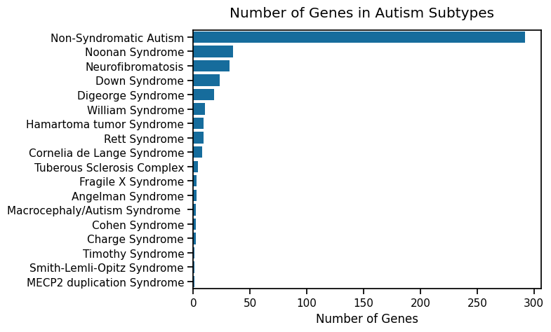
Data Processing: Regrouped autism subtypes
Each subtype were identified by keyword searching.
Ambiguous diagnoses were grouped, e.g., autistic disorder & autistic spectrum disorder.
Different types of a syndrome were grouped, e.g., Smith-Lemli-Opitz Syndrome, Type I and Type II.

Slide 5
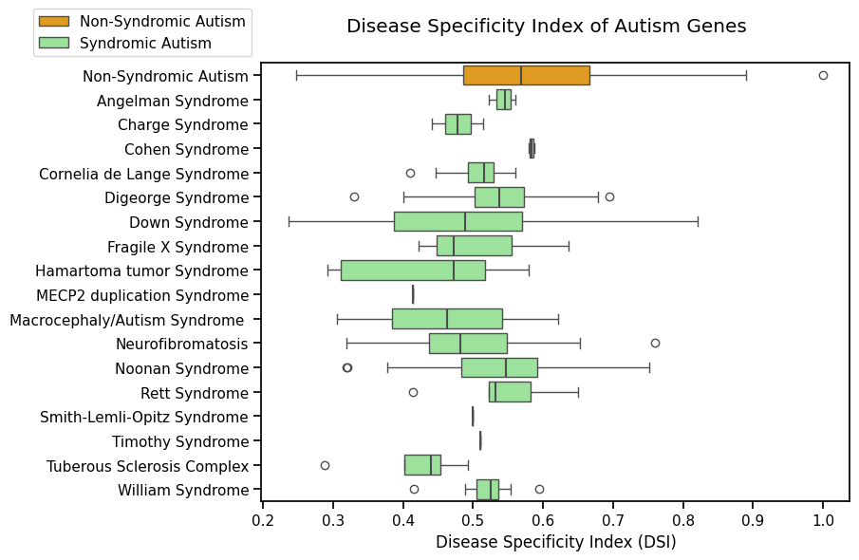
Autism Gene Metrics: Disease Specificity Index (DSI)
DSI ranges from 0 to 1.
Inversely proportional to the number of diseases associated to a particular gene.
0: gene associated with many diseases.
1: gene associated with only 1 disease.
(Piñero et al., 2020)

Slide 6
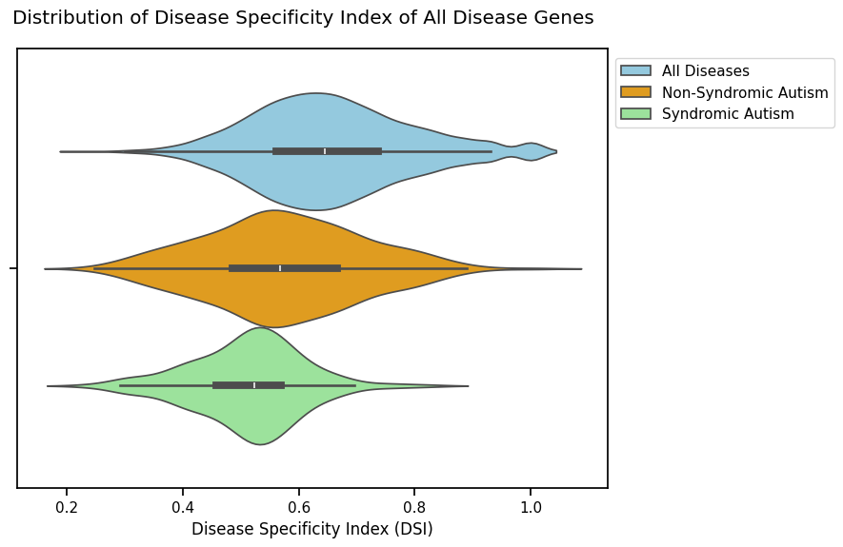
Disease Specificity Index (DSI) of All Genes
Compare with all genes, genes involved in autism tend to be less disease-specific.
In other words, they tend to be involved in a wide range of diseases.
What test could we do? The samples are not independent.

Slide 7
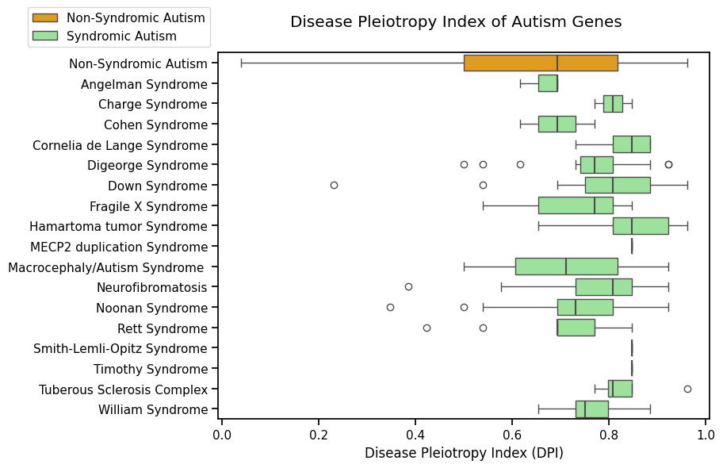
Autism Gene Metrics: Disease Pleiotropy Index (DPI)
DPI ranges from 0 to 1.
Proportional to the number of different (MeSH) disease classes a gene is associated to.
0: gene associated with 0 class.
1: gene associated with many classes.
(Piñero et al., 2020)

Slide 8
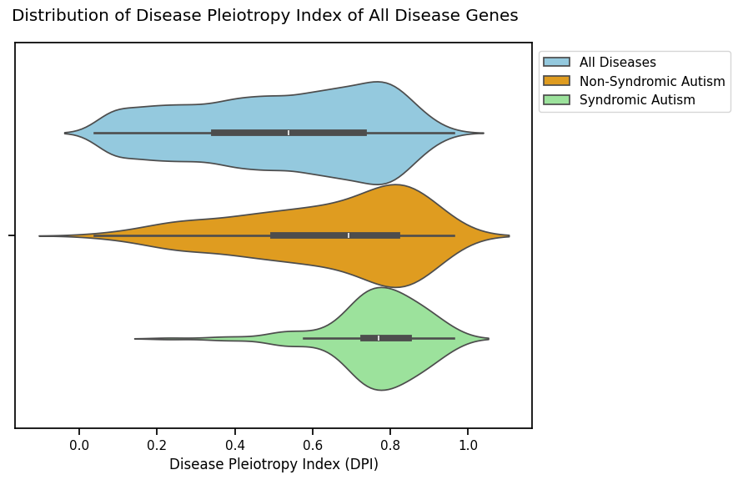
Disease Pleiotropy Index (DPI) of All Genes
Compare with all genes, genes involved in autism tend to be associated with more disease classes.
Worth noting that non-syndromic autism only belong to one disease class – psychiatric disease, but all other syndromic autism does belong to multiple classes.
What test could we do? The samples are not independent.

Slide 9
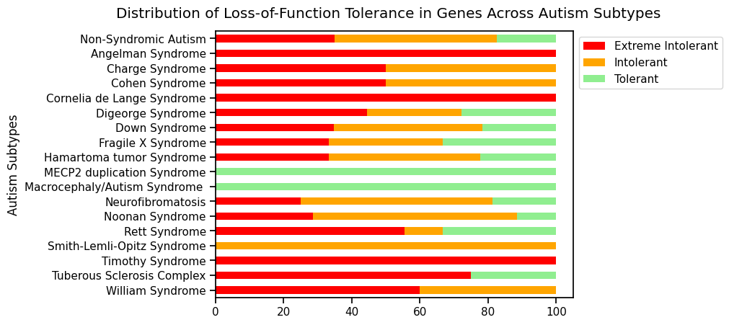
Autism Gene Metrics: Loss-of-Function Tolerance(LFT)
Each gene has a gene metric – pLI, i.e., probability of being loss-of-function intolerant. Mutations to genes with high pLI has higher probability of causing disease (Fuller et al, 2019).
LFT classification based on pLI:
LoF extr. intolerant: pLI >=0.9.
LoF intolerant: 0.9 >= pLI >=0.1
LoF tolerant: 0.1 >= pLI

Slide 10
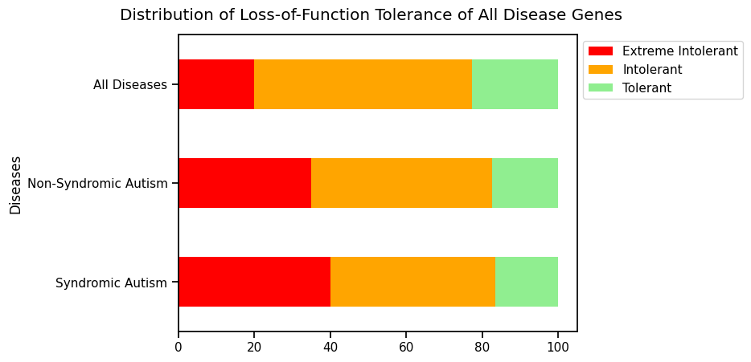
Loss-of-Function Tolerance(LFT) of All Genes
Compared with all genes, genes involved in autism tend to be less tolerant to mutations.
Any statistic test could we do?

Slide 11
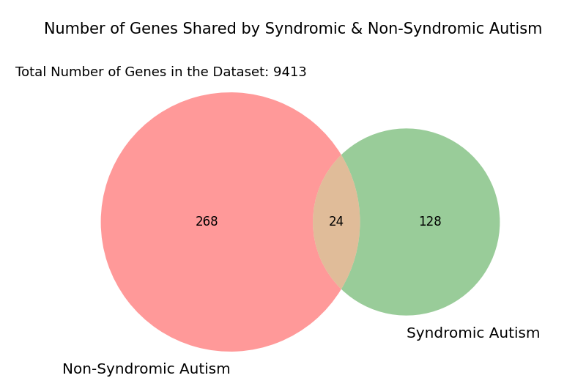
Shared Genes

Slide 12
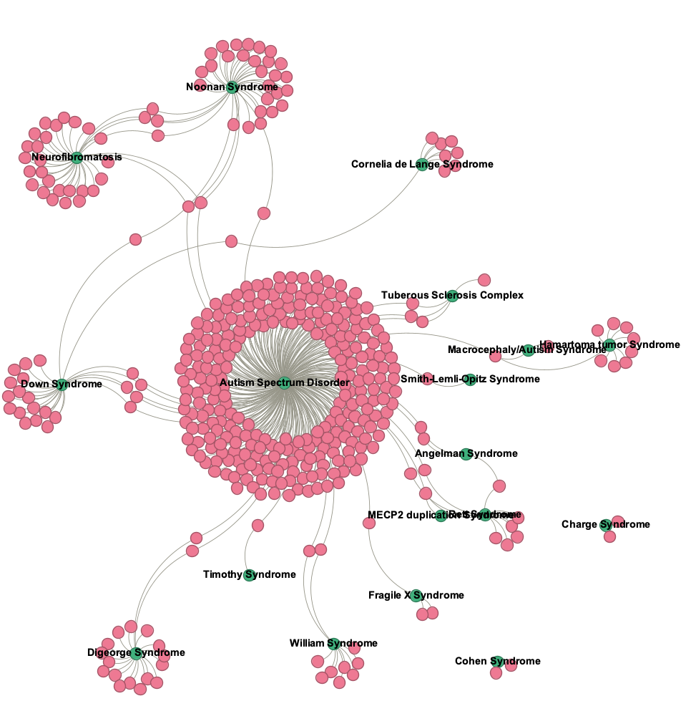
Autism-Gene Bipartite Network
Most genes are associated with non-syndromic autism.
Genes connect
non-syndromic autism to syndromic autisms
subtypes of syndromic autism to each other.
Cohen syndrome & Charge syndromes do not share genes with other disorders.

Slide 13
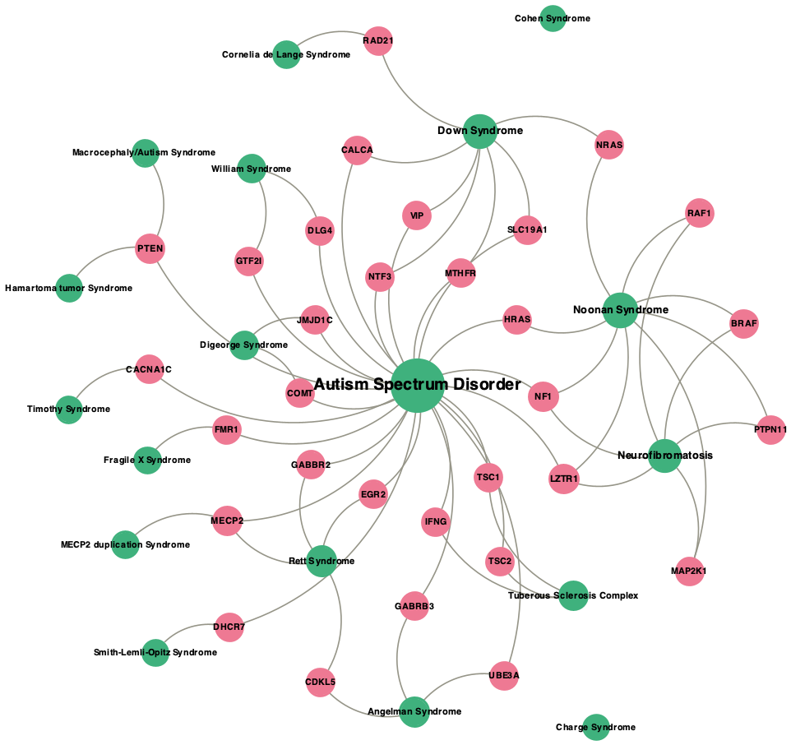
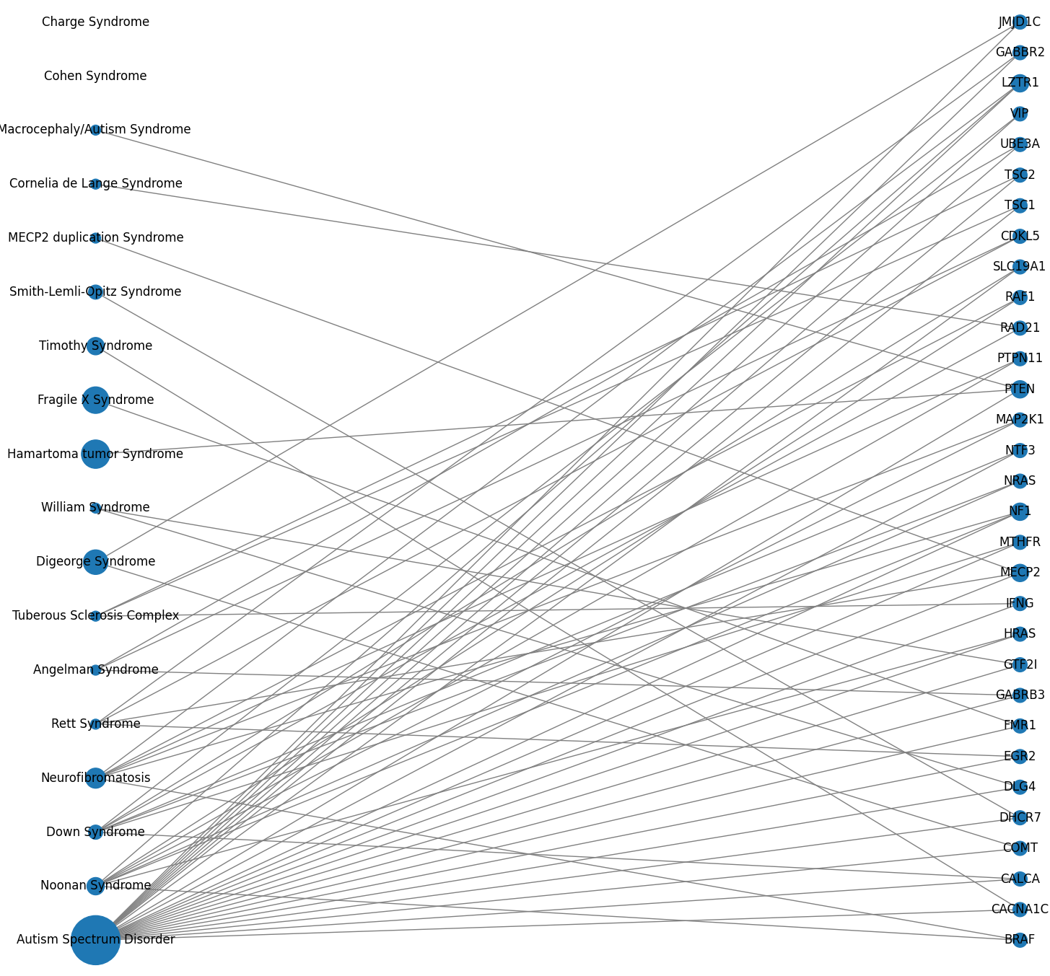
Trimmed Bipartite Network: Identify Potentially Important Genes
Autism
Genes

Slide 14
Autism Disease Unipartite Network
Diseases are nodes. An edge exists between two diseases if they share genes.
The p-value of edge is calculated using hyper-geometric test.
I.e., given that the total number of gene (N=9413), disease A with n₁ of genes, and disease B with n₂ of genes, what is the probability that these two diseases share k genes?
Edges are kept only if their p-value smaller than 0.05.
4 subtypes not connecting to any other subtype.
Note:
*: p<.05; **: p<.01; ***: p<.001; ****: p<.0001;

Slide 15
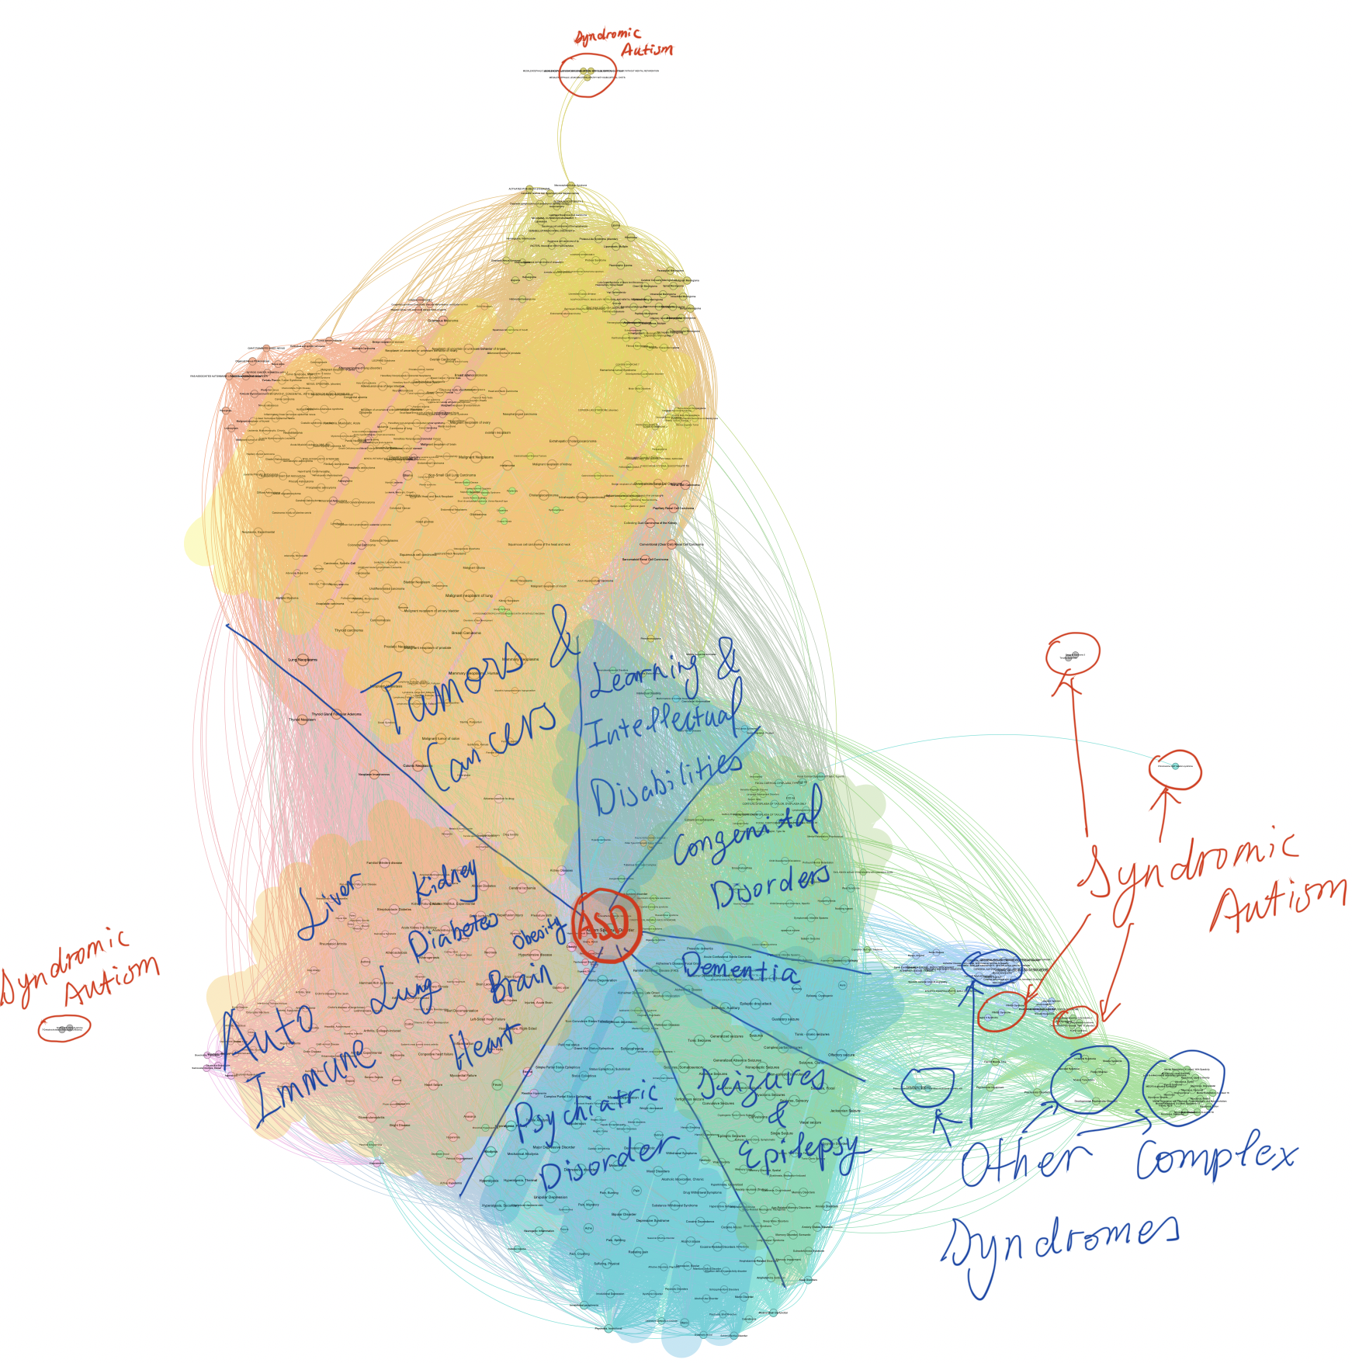
Disease Network for Autism & Their Neighbors
728 nodes/diseases, 29495 edges
Network density: 0.1149
Edges are kept only if their p-value smaller than 0.0001. Edge weight = -log(p), truncated at 10
Non-syndromic autism (i.e., autism spectrum disorder) is located at the center of network.
All syndromic autisms are floating at the peripheral of the network.
Modularity calculation generated 11 modules. Here are more significant ones:
26.4% + 10.58% + 3.71%: ASD, psychiatric disorders, seizures, dementia, congenital disorders, learning disabilities, autistic and other complex syndromes
28.85% + 13.19%: cancer & tumor
15.66%: heterogeneous disorders relating to different physiological systems, e.g., autoimmune system*, heart, lung, kidney, lung, and diabetes

Slide 16
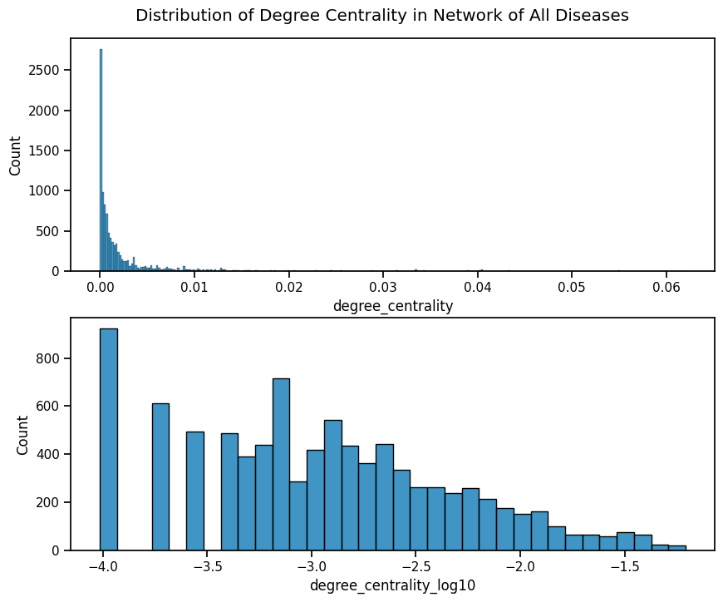
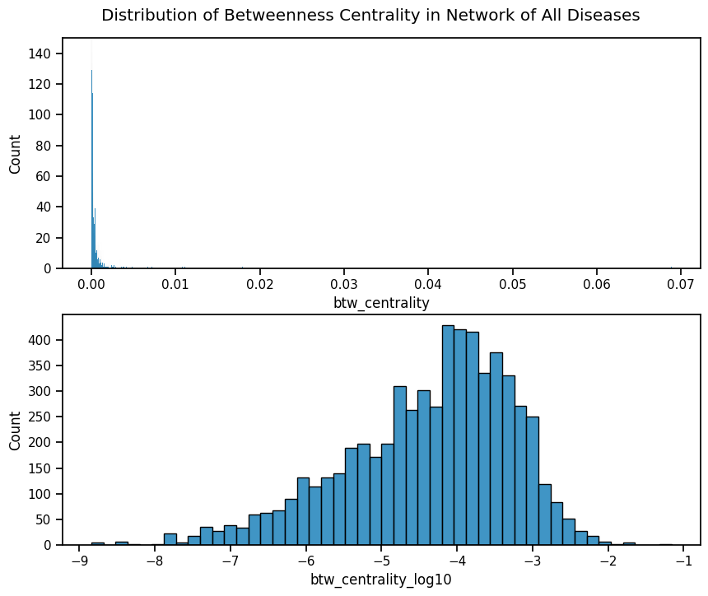
Network (p<.0001) Centrality Metrics: All Diseases

Slide 17
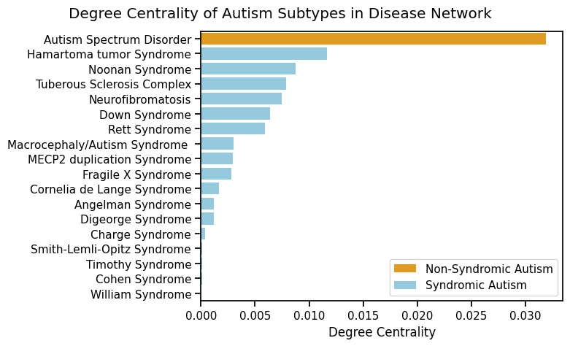
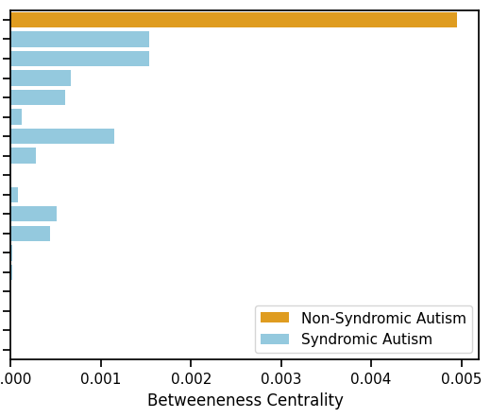
Network (p<.0001) Centrality Metrics: Autism Subtypes
Degree Centrality and Betweenness Centrality of Autism Subtypes in Disease Network
Notes:
Degree centrality: number of edges / all possible edges
betweenness centrality: number of short paths passing through of the nodes/ all short paths

Slide 18
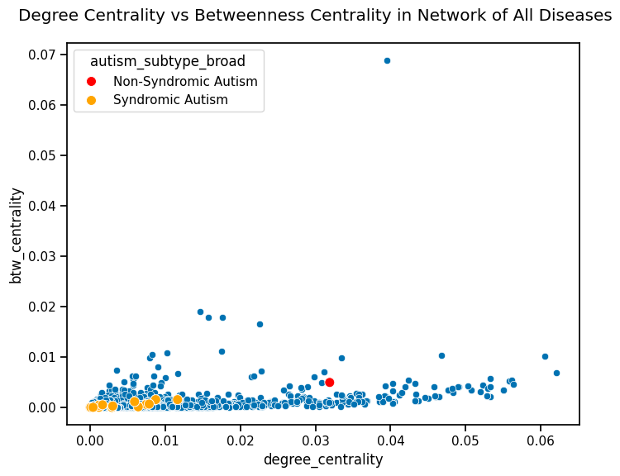
Network Centrality Metrics for Autism
Data points clustering due to skewed distribution.

Slide 19
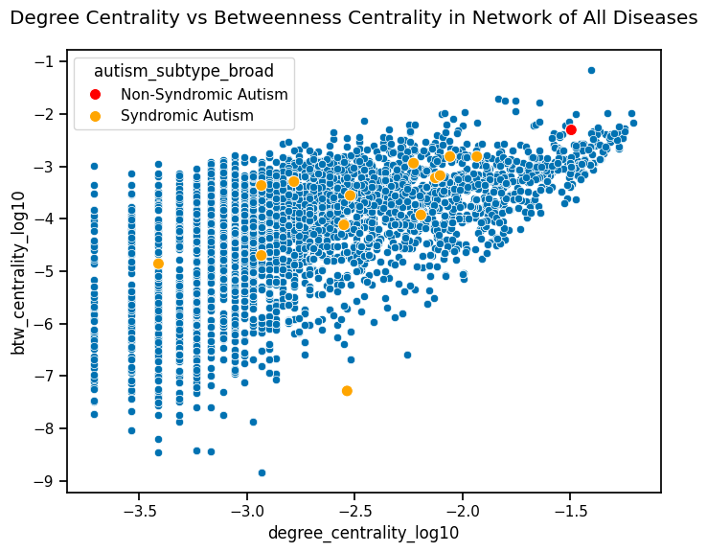
Does Non-Syndromic Autism Really Behave Differently?
A lot of data are ceiling at 0 and not shown here due to log transformation.
Some purely mono-genetic diseases might not show in the graph, because their centrality measurement is probably 0.
Is it appropriate to use Pearson’s or Spearman’s correlation analysis here?
Notes:
Degree centrality: number of neighbours / number of potential neighbours
Betweenness centrality: number of shortest paths passing through the node / number of all shortest paths

Slide 20
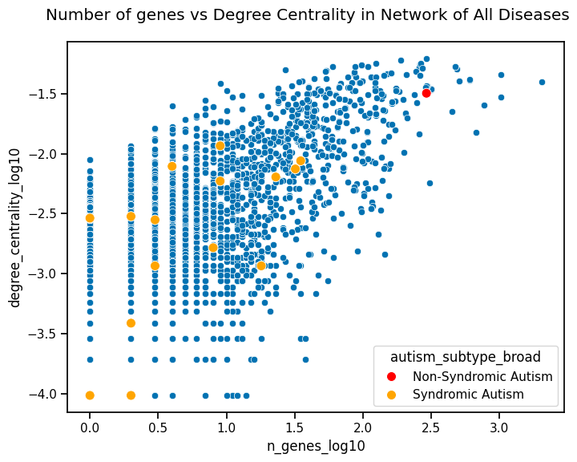
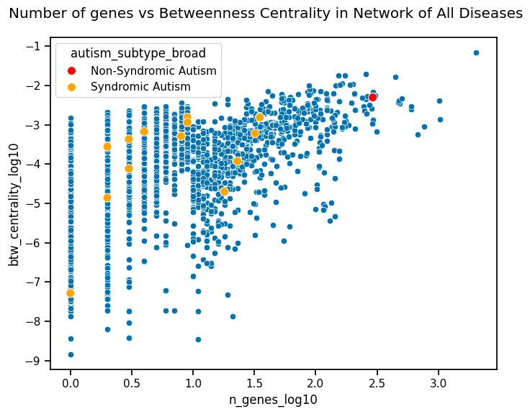
Network Centrality Metrics for Autism

Slide 21
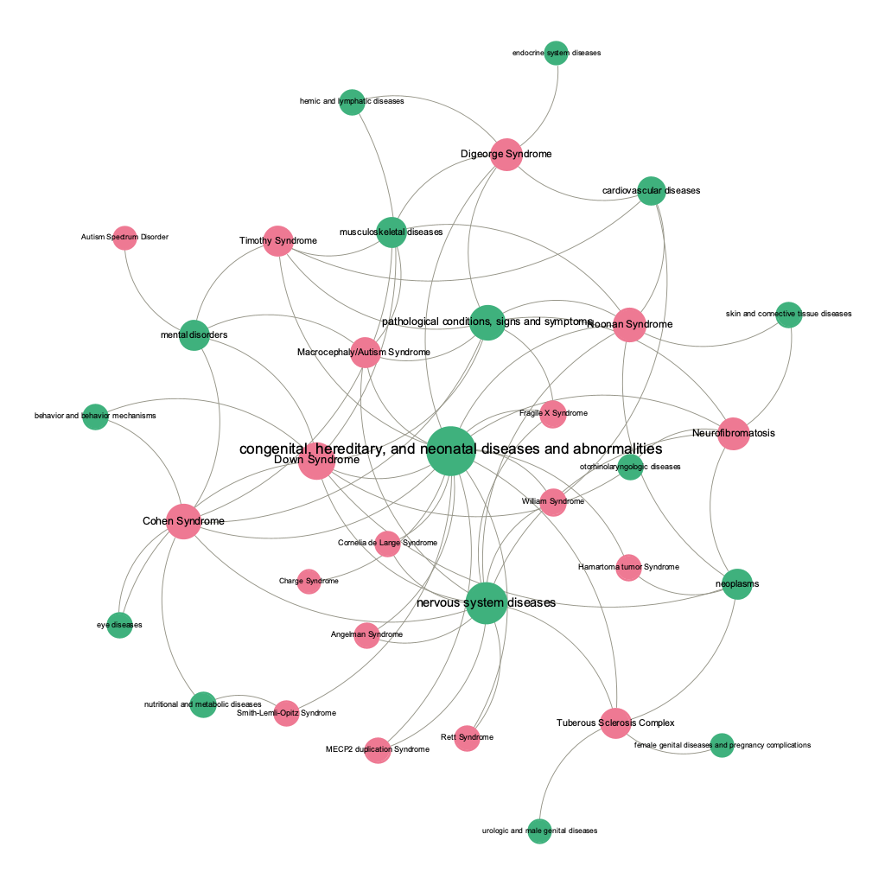
Autism and Disease Class Bipartite Network
By contrast, Syndromic autism dominates over non-syndromic autism in a network of autism and disease classes.
As syndromic autism diagnosis considered to involve multiple disease diagnosis class.
Question:
Non-syndromic autism dominates in gene-disease network, as non-syndromic autism entails more genes than syndromic autism?
Syndromic autism dominates in gene-class network, as syndromic autism involves more disease class?

Slide 22
Limitation
I did not do much statistical testing, because I was not sure which proper statistical test to use for dependent samples as well as network measurements.
Hypermetric testing biases against diseases with small number of genes, e.g.,
Mono-genetic and mendelian disorders
Understudied disorders, e.g., the -log10(p-value) between autism and ADHD was only ~3.3, despite 50-70% comorbidity in clinical population. Because such big datasets often tend to bias toward rare diseases.
But keeping edges with p-value below .0001 -> too many false positive.
Further analysis – enrichment analysis?

Slide 23
References
Fuller, Z. L., Berg, J. J., Mostafavi, H., Sella, G., & Przeworski, M. (2019). Measuring intolerance to mutation in human genetics. Nature Genetics, 51(5), 772-776.
Tick, B., Bolton, P., Happé, F., Rutter, M., & Rijsdijk, F. (2016). Heritability of autism spectrum disorders: a meta‐analysis of twin studies. Journal of Child Psychology and Psychiatry, 57(5), 585-595.
Sztainberg, Y., & Zoghbi, H. Y. (2016). Lessons learned from studying syndromic autism spectrum disorders. Nature neuroscience, 19(11), 1408-1417.
Piñero, J., Ramírez-Anguita, J. M., Saüch-Pitarch, J., Ronzano, F., Centeno, E., Sanz, F., & Furlong, L. I. (2020). The DisGeNET knowledge platform for disease genomics: 2019 update. Nucleic acids research, 48(D1), D845-D855.

